Slide 1
Providing an Research Environment for life sciences
David Brown
24th January 2018
www.genomicsengland.co.uk

Slide 2
Background
Genomics England has been setup to deliver the UK 100K Genome programme.
As part of the charter of Genomics England and the 100K genome programme no data can be downloaded.
Therefore Genomics England has had to create an research environment to allow researchers to work with the Genomics England dataset.
The need to address the needs of three categories of user:
Bio-informatics – ’just give me the prompt’
Scientist with no programming skills
Management

Slide 3
Research Environment
Virtual Desktop
Access
DataBology
Pipeline Pilot
R
Command line tools
Analysis
Python API
Rights Management
Clinical and Phenotypic Data
LabKey
Variant Library
OpenCGA
Read Level Data
File storage
Data

Slide 4
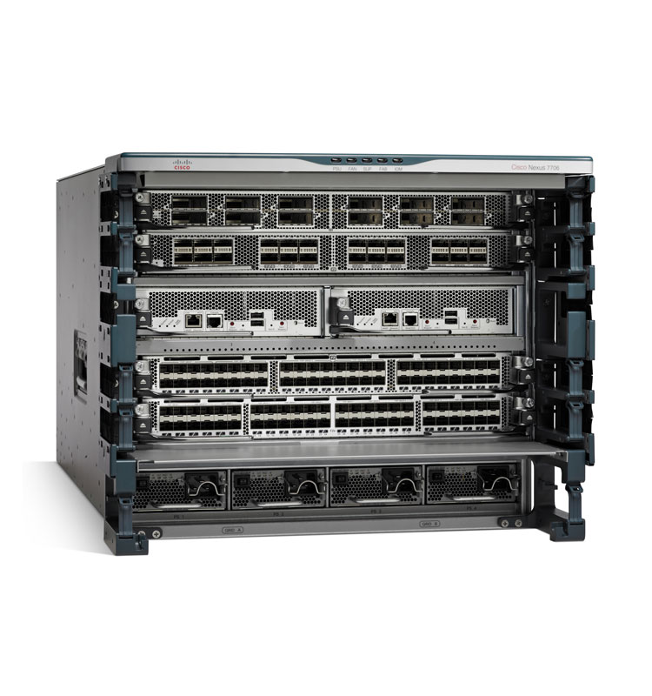
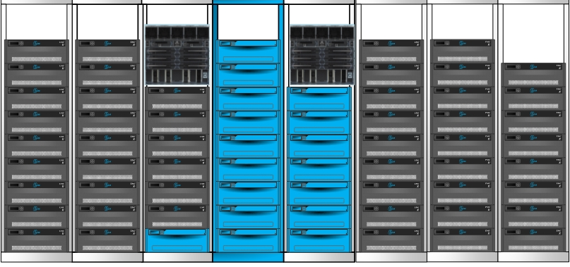
Physical Environment – Hybrid Cloud
Expansion
10PBs of additional storage
Hadoop Cluster
Backup Subsystem
Spine
Switch
HDFS
Multiple 10GiB/s
2,000 cores
18,000 cores
160GiB/s
Spine switch
Isilon Storage
Cluster
Initial 6.4PBs deployed in Corsham 300TBs deployed in Farnbrough

Slide 5
Major Factors
Initial speed of implementation - when GEL was in startup we had 3 months to be able to accept sequences. Only a cloud solution could address these time scales.
Compute demand is not constant – there is a need to flexi based on project demand
Project timescales v’s rate of technology change – the adoption of any research environment is always slow than you plan, if you invest in technology early is will be obsolete by the time it is used

Slide 6
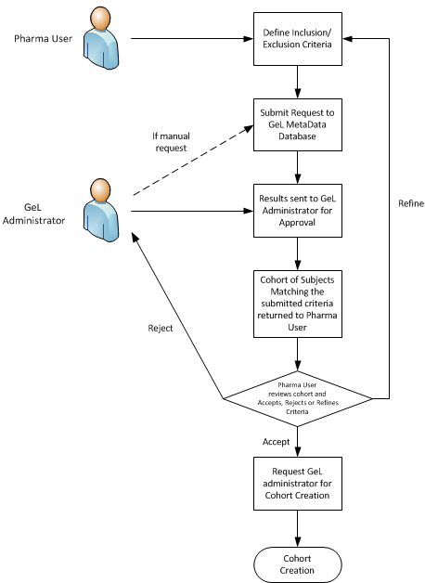
Compute Demand Types
Traditional HPC Scheduled Grid Compute
Static Centralized Resource
On-Demand Compute with ‘thick nodes’
Pop-up environment created by research team on demand
Searching on ‘research repository’
Head Node
Head Node
Submit Image
Cloud Control
Submit Image
Submit Job
Embassy
Secure Compute Env
Submit Job
Grid Master
Grid Master
Thick Node
24 core 256GB RAM
Grid Exec
Grid Exec
Grid Exec
Grid Exec
Grid Exec
Embassy
Data
Secure Compute Env
Data

Slide 7
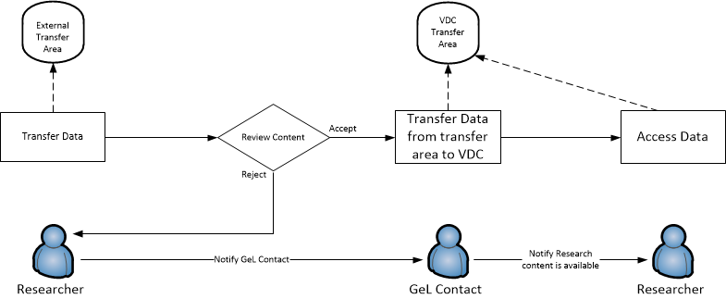
Airlock
The airlock is there, the issue now is who validates inbound and outbound data, this isn’t an IT issue!

Slide 8
Research Environment front end performance
300mls

