Slide 1
The rise of cloud? Insights from Digital Health Intelligence
Karl Grundy, director
Tara Athanasiou,
director of research

Slide 2
Rise of Cloud
In summary
G Cloud Sales – started February 2014
£2.4 bn
47% of total sales SME
83% central government
17% rest of public sector
Why is Health lagging behind?

Slide 3
Healthcare barriers
Information Management
What to put in the cloud
What to use cloud for SaaS, IaaS, PaaS
£’s Investment
Asset sweating
Security
Contracts
Suppliers
Is anyone asking you to use the cloud
Do you want to use the cloud

Slide 4
Attitude

Slide 5
Some advice
In summary
GDS guidance
Elasticity and resilience
Pay as you go pricing
Falling costs
Management tools
Best of breed security
Flexibility and opportunity costs
NCSC guidance and questions
14 Cloud Security Principles
Is your executive team asking you why you are not using the cloud
Have you got your business case together
Changing the IT department

Slide 6
Our data
In summary
NHS infrastructure data collection, 2017
121 acute trusts
42 mental health trusts
New section on cloud – reflects changing priorities
Census-level insight on suppliers, contract renewal dates and contract values
NHS IT Leadership Survey, 2017
Snapshot of priorities, plans and sentiments of NHS IT leaders
Second annual survey
152 responses
New section on cloud

Slide 7
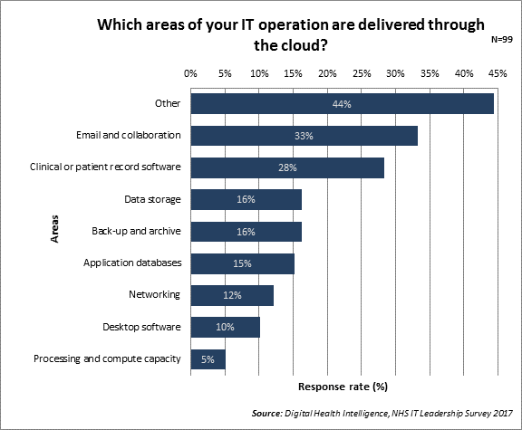
Cloud today
In summary

Slide 8
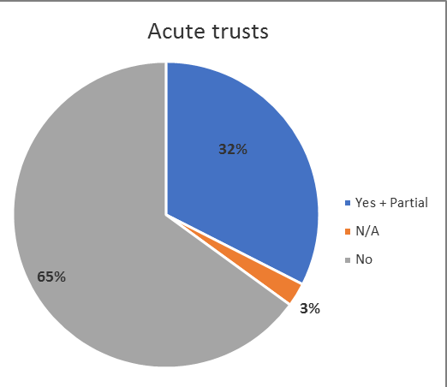
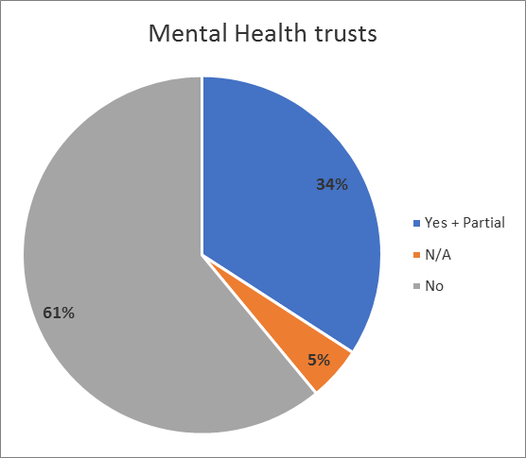
Infrastructure in the cloud – the picture today
Notes:
Very similar adoption levels in acute and mental health trusts
Low levels of adoption currently. Increasing pressure on budgets and staff, plus additional need for more computing power will mean this will increase
Trusts who have started delivering through the cloud report benefits of this:
Quicker and easier to switch on new services – don’t need to procure the infrastructure to support this, just get cloud supplier to do it
Cyber security – services delivered through cloud can harness higher levels of security than any one single NHS organisation could invest in
Easier to measure costs. Trusts find it difficult to implement upgrades of, for example, data storage facilities in-house. A benefit of cloud is knowing they won’t have to go through this process
Less remedial work for in-house team
Hard to attract and retain IT staff – cloud takes pressure off

Slide 9
Where are highest levels of cloud?

Slide 10
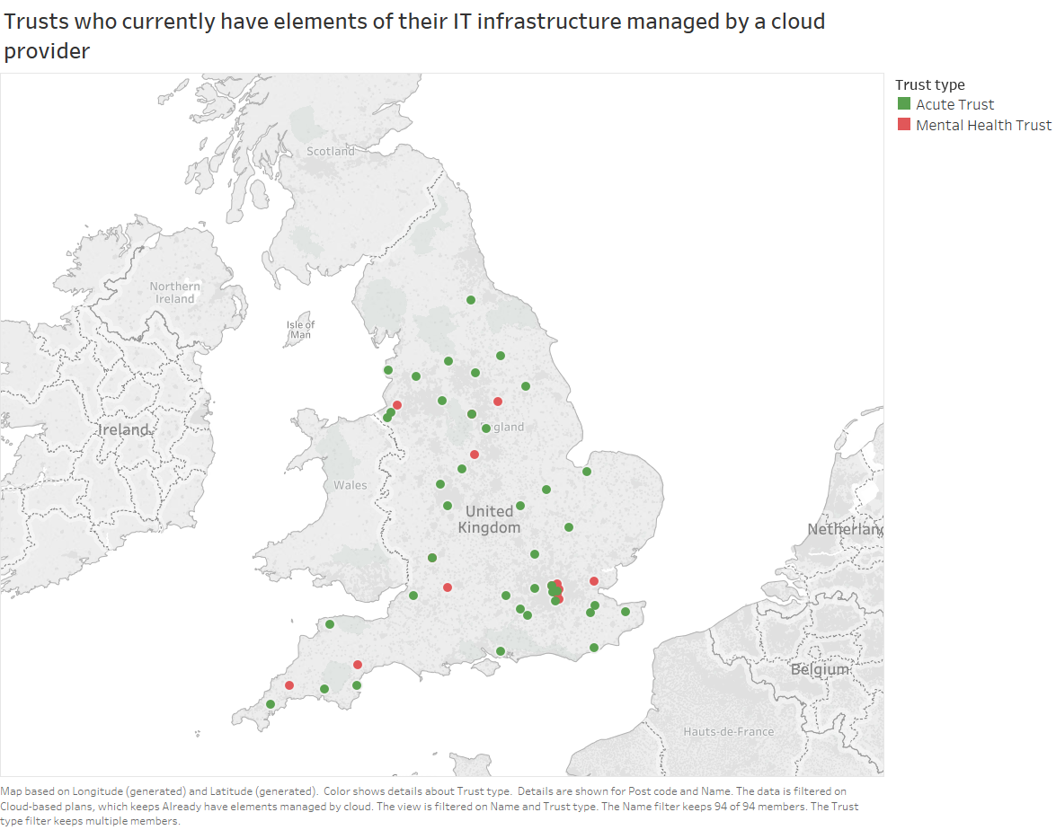
Infrastructure in the cloud – a regional picture

Slide 11
Case study: University Hospitals Bristol NHS FT
In summary
Some processing and compute and application databases in the cloud, currently provided by Microsoft Azure
Has made it easier to understand future cots, compared to establishing costs for maintaining in-house data storage and compute facilities
Incremental approach – mix of traditional and cloud-based storage and compute capability
Big shift in thinking – some not comfortable with cloud
Notes:
“I believe that cloud will increasingly be the data storage and compute solution of choice, especially when it’s offered as part of a supplier package for application software and other services.”
Steve Gray, Clinical Systems Programme Director

Slide 12
How NHS IT leaders view the cloud
In summary
Quicker and easier to switch on new services – no need to procure new infrastructure
Provides the compute power to enable emerging techs – AI, machine learning, population health management
Cyber sec benefits – cost-effective access to high levels of security and data availability
Easier to measure costs – pay for what you need
Less in-house remedial work
Quicker and easier to roll-out regular software and security updates
Notes:
Trusts that have started to deliver elements of their infrastructure through the cloud report numerous benefits, including:

Slide 13
Future plans of NHS IT leaders
Notes:
New infrastructure data collection provides census level data on what IT infrastructure is currently delivered by a cloud provider and what areas they plan to move to the cloud in the next 2 years
The responses from NHS IT leaders about their future plans for cloud indicate they expect to make significantly more use of cloud-base services.
Back-up and archive is the highest category that most digital leaders expect to move to cloud-based services in the next two years, identified by 34% of respondents. Data storage and email and collaboration were also identified as areas likely to move to the cloud in the next two years, by 32% and 31% of respondents respectively.
At the other end of the spectrum, processing and compute power and networking were less likely to move to the cloud in the next two years, with 18% and 9% of respondents respectively.
34% of digital leaders chose the response category ‘other’. This suggests that even though NHS organisations are showing an increased level of interest and procurement activity in cloud-based services, many are still choosing to stick with traditional on-site delivered services.

Slide 14
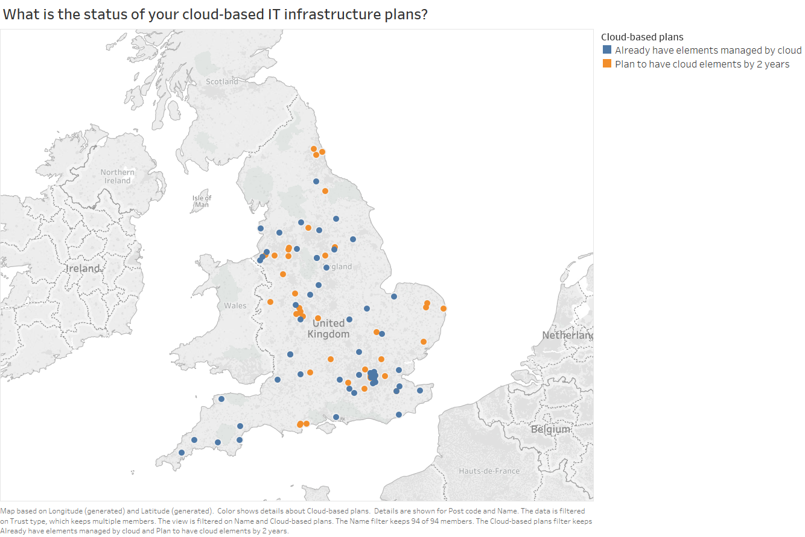
Future plans – the regional picture
In summary
Notes:
This section, introduced for the first time in the 2017 survey, examines the levels of cloud computing already seen in NHS organisations, and intentions to move to cloud-based services in the future. NHS IT leaders were asked which areas of their IT operations are currently delivered through the cloud. A third said email and collaboration, with clinical or patient record software coming next, with 28%. There is relatively limited adoption of cloud services in the other areas, ranging from data storage and back-up and archive, with 16% of digital leaders responding that these are currently delivered through the cloud, to processing and compute capacity, with just 5%. However, 44% responded to ‘other’, indicating that further work is needed to better understand the use of cloud in the NHS.

Slide 15
Key insights
In summary
The cloud has been touted as the next big paradigm shift for the NHS
Cloud adoption comparatively low, but growing
67% of trusts do not have any element of IT infrastructure delivered though the cloud
Most trusts are taking an incremental approach
We will see a tipping point in the next two years as traditional infrastructure contracts end

Slide 16
Thank you
In summary
For more information, get in touch:
karl@digitalheath.net
tara@digitalhealth.net

